Slide 1
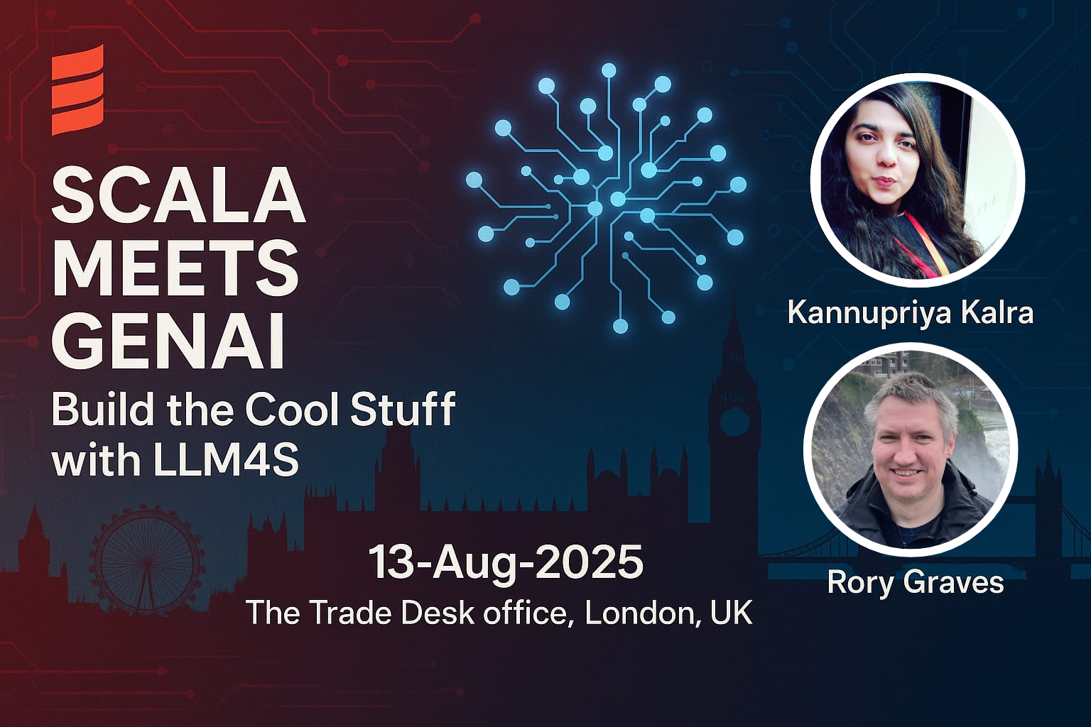
Notes:
Good Evening, everyone.
It is a pleasure to be here today in London. My name is Rory Graves, and with my colleague Kannupriya, we are here to present "Scala Meets GenAI: Build the Cool Stuff with LLM4S." Just six months ago, a core idea we had within the London Scala community quickly became a mission. We recognized a significant opportunity to bridge Scala's robust capabilities with the innovative power of Generative AI, and we identified a critical need for a community-driven toolkit. This led to our dual ambition: to develop LLM4S, a practical, Scala-first AI toolkit, and to cultivate a global community around it.
We are immensely grateful for the crucial support from the global Scala community and our partners, whose encouragement and collaboration have been instrumental to our progress. Our hearts are full as we head into our first public demo in London, the exact place where the seed was planted just six months ago: SZork, a game built entirely with LLM4S. We are excited to share with you what we have built. Kannupriya and I will be demonstrating the capabilities of LLM4S and showing you the exciting potential of this powerful toolkit. Thank you.

Slide 2



Let's Play Szork!
100% Scala-Powered AI Adventure
Notes:
This is SZork - a fully AI-powered text adventure game. Everything you're about to see - the story, the images, the music - is generated in real-time by AI, orchestrated entirely through Scala and LLM4S.

Slide 3


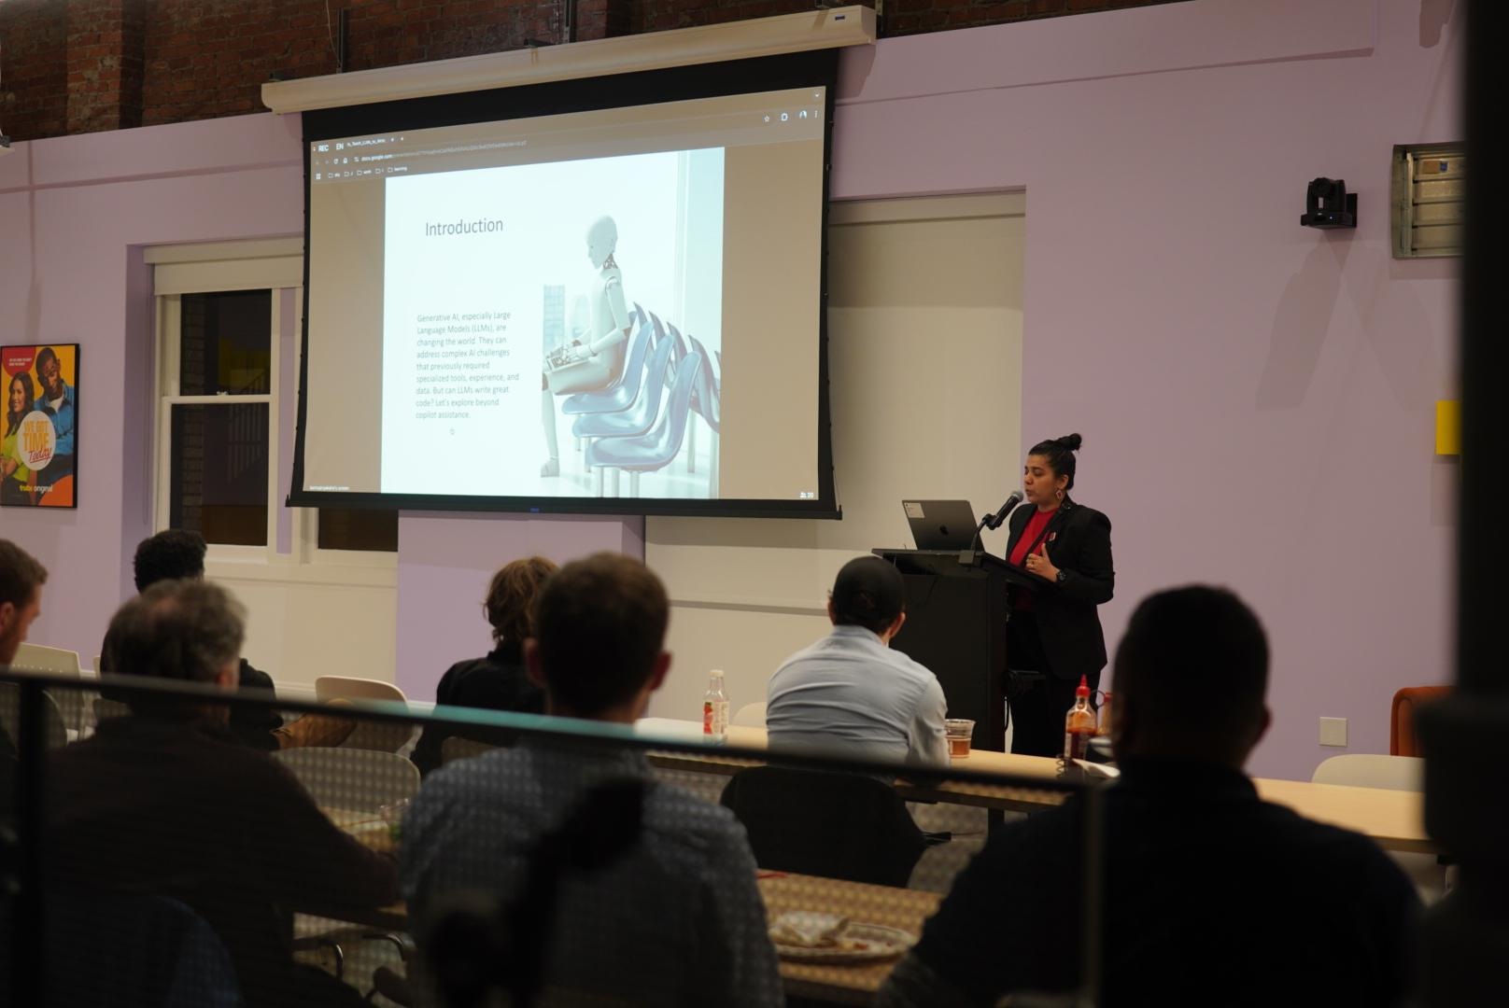
The Magic Behind the Scenes
Notes:
[Open browser dev tools] Look at this - every aspect is powered by different AI services, all orchestrated through LLM4S. No Python, no JavaScript AI libraries - pure Scala managing this complex multi-modal experience.

Slide 4

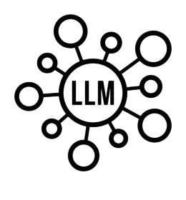




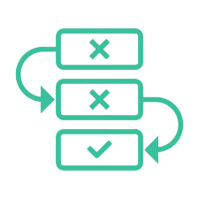
Szork's Inner World 🪄
→ LLM as DM : Narrative generation & game state tracking
→ Speech-to-Text : Voice commands
→ Text-to-Speech : Spoken responses
→ Image Generation : Dynamic scene illustrations
→ Tool Calling : Inventory, combat, puzzles
→ Agentic Workflows : DM manages state and game flow
Notes:
Here’s a look at the secret sauce behind SZork!
LLM as DM: This is where it all begins. The Large Language Model isn't just generating story; it's the brain of the game, creating the narrative and tracking every detail as you play.
Speech-to-Text & Text-to-Speech: This is how you talk to the game and how the game talks back. Use your voice to give commands and hear the Dungeon Master's spoken responses, making it feel truly conversational.
Image Generation: To make the world come alive, we're generating dynamic scene illustrations in real-time. The story isn't just in your head—it's on the screen.
Tool Calling: This is how we handle the game mechanics. The LLM can use tools to manage your inventory, orchestrate combat, and solve puzzles, keeping everything organized and logical.
Agentic Workflows: And finally, all of this is tied together with agentic workflows. They ensure the DM stays in control, orchestrating the entire experience from start to finish. It’s what makes the magic happen!

Slide 5



Who We Are 🤔
Rory Graves
A Scala advocate and software engineer with 30+ years of experience across diverse systems. He has contributed to Scala compiler optimizations and supports AI/ML research while mentoring developers. Beyond tech, he is a martial artist, windmill tour guide, and public speaking mentor. LinkedIn: https://www.linkedin.com/in/roryjgraves/
Kannupriya Kalra
Backend engineer and community leader specializing in type-safe, functional AI development. Creator of LLM4S, a Scala-first toolkit inspired by LangChain and Pydantic, she brings structure and reliability to generative AI. With 10+ years’ experience, she’s led engineering at Sky, mentored Google Summer of Code contributors, and spoken at conferences worldwide, shaping how typed languages integrate with modern AI. LinkedIn: https://www.linkedin.com/in/kannupriyakalra/
Notes:
I’d like to take a moment to introduce the maintainers of LLM4S. The passion and expertise behind this project are what make it truly special.
First, meet Rory Graves. He is a Scala expert with over 30 years of experience, and his contributions to Scala compiler optimizations and AI-driven research have been invaluable. A huge thank you to Rory for being an amazing co-maintainer on this project, and for the opportunity to work alongside him.
And I am Kannupriya Kalra. As the creator of LLM4S, my work focuses on type-safe, functional AI development, bringing structure and reliability to generative AI. With over 10 years of experience, I’ve had the honor of working in engineering teams at Sky, mentoring Google Summer of Code contributors, and speaking at conferences worldwide.

Slide 6

Notes:
At LLM4S, our core mission is to help people grow in their careers and create opportunities for everyone, including students, to learn AI by doing AI. It was with this purpose that we proudly participated in the Google Summer of Code 2025 program. This year, we were honored to welcome four outstanding contributors from around the world. Each of them tackled a unique and challenging project, from agentic LLM toolkits and advanced tracing tools to RAG-in-a-Box and multimodal LLMs. Their work has been instrumental in pushing our technology forward and, in partnership with Scala Center, has significantly strengthened our global open-source community. We have been incredibly impressed to witness their rapid growth and are proud to see them become confident open-source contributors.

Slide 7

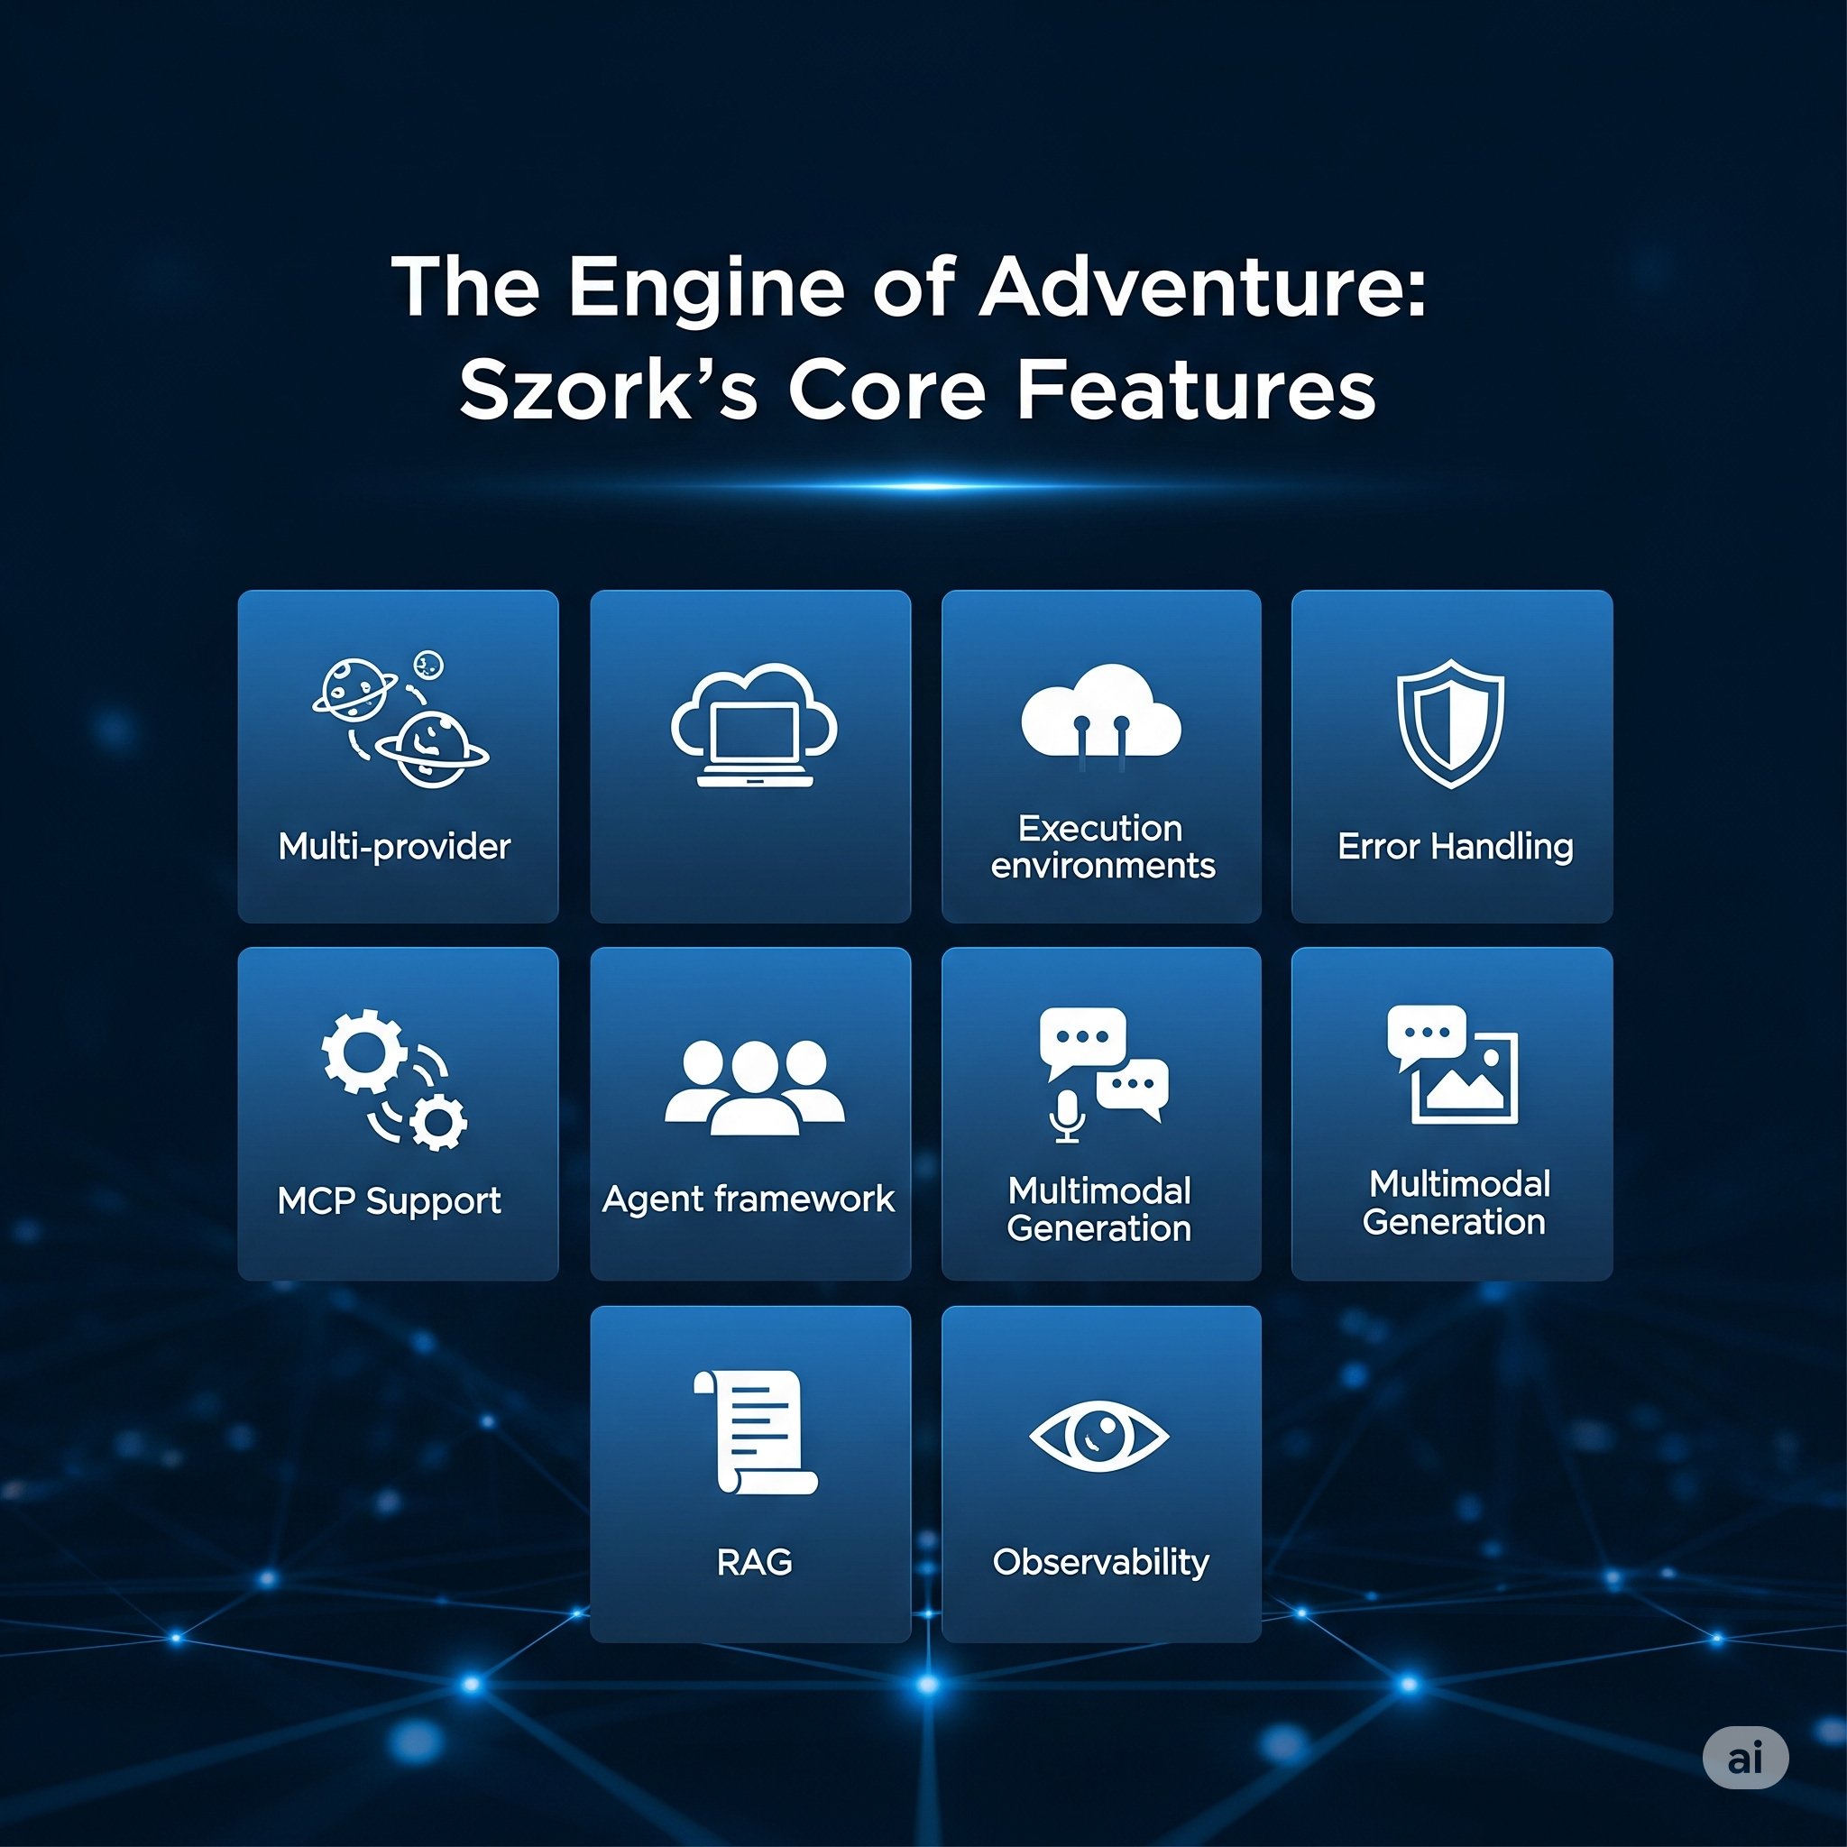

Production Features
LLM4S Production Features
- Multi-provider
- Execution environments
- Error Handling - MCP Support
- Agent framework
- Multimodal Generation
- RAG - Observability
Cross Scala Support
Notes:
This isn't a toy - it's battle-tested in production. Switch providers with one line. Full observability with Langfuse. MCP support for standardized tools. Graceful degradation when services fail.

Slide 8

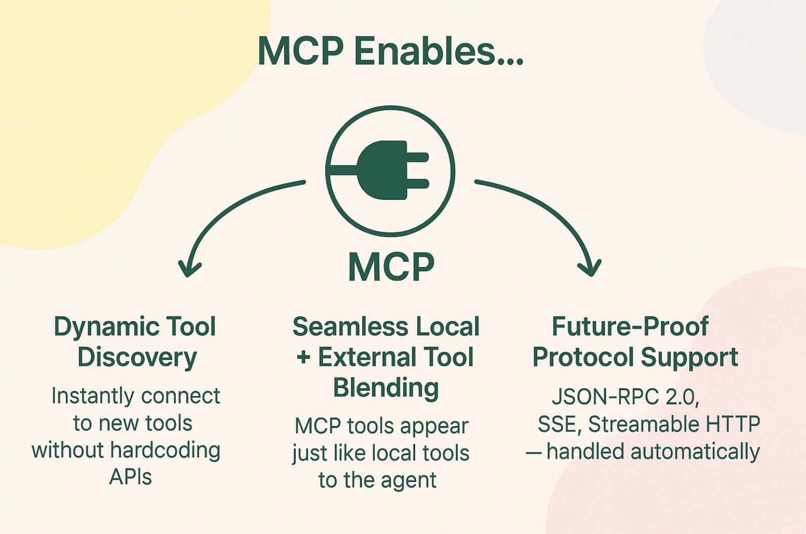
Model Context Protocol
MCP extends LLM4S agent's possible toolset and allows developers to seamlessly connect to any MCP server.
Plug into any tool, effortlessly
Notes:
MCP extends LLM4S agent's possible toolset and allows developers to seamlessly connect to any MCP server. - Elvan Think of MCP as a universal adapter for our agent’s tools. Right now, every time you want to add a new tool, you have to custom-wire it: learn its API, handle edge cases, and pray the next version doesn’t break your integration. That slows innovation and eats resources.
With MCP, that pain disappears. We give your agent a single universal protocol to talk to any tool — local or remote — instantly. No rewrites, no new architecture, no lock-in. You just connect, and the agent knows exactly how to use it.
This means you can integrate your company’s internal systems, tap into new APIs, or even plug in tools you haven’t built yet — all without touching your core code. It’s not just future-proof; it’s opportunity-proof.
For teams using LLM4S, MCP turns your agent into a platform — one that can grow capabilities on demand, adapt to market changes instantly, and keep you ahead of competitors who are still hardcoding integrations. In short: its less dev time, more market-ready features, faster.
For LLM4S, that means more capability with less coupling. Agents become explorers in an ever-expanding tool ecosystem, and we decide the mix – local or remote, without touching the core. Seamless, scalable, sustainable.

Slide 9
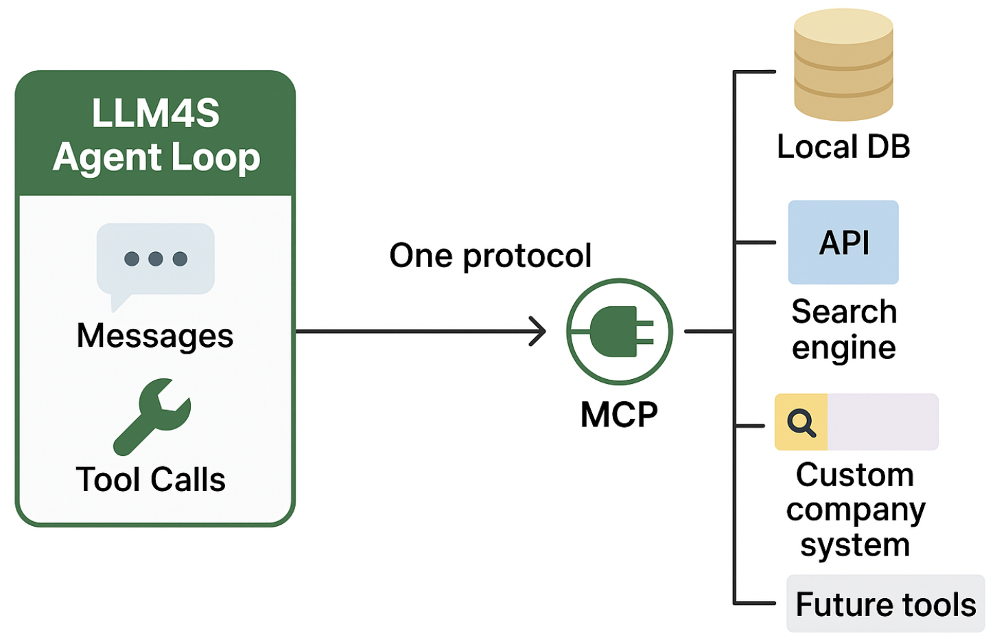
One Protocol. Every Tool. Powered by LLM4S.
One Protocol, Any Tool – MCP unifies every tool source — from local DBs to cloud APIs to future systems — into a single interface your agent already understands.
Agent Loop Ready – The LLM4S agent loop handles messages and tool calls natively; MCP just drops new capabilities straight into that flow, no code changes.
Scalable by Design – Add, swap, or upgrade tools without touching the core → growth without friction.
Notes:
If the first slide is about what MCP does, this one is about why LLM4S makes it shine.
LLM4S already has a clean, scalable agentic loop — messages and tools flowing in a way that’s predictable and easy to extend. MCP is the perfect upgrade: it unlocks instant access to any external tool without changing that loop.
Imagine you’re shipping an enterprise AI assistant. One week your client wants SAP integration, the next it’s Salesforce, and next month it’s their proprietary warehouse system. Normally, that’s three separate engineering projects. With MCP inside LLM4S, it’s one protocol — just register the tool, and the agent is ready to call it.
And because we integrated MCP without touching the core architecture, you get all of this without sacrificing stability or maintainability.
As MCP evolves — new specs, new transport methods — LLM4S evolves with it. You stay at the cutting edge, without the churn.
In short, if MCP is the universal adapter, LLM4S is the power grid that makes sure it always works at full capacity.

Slide 10


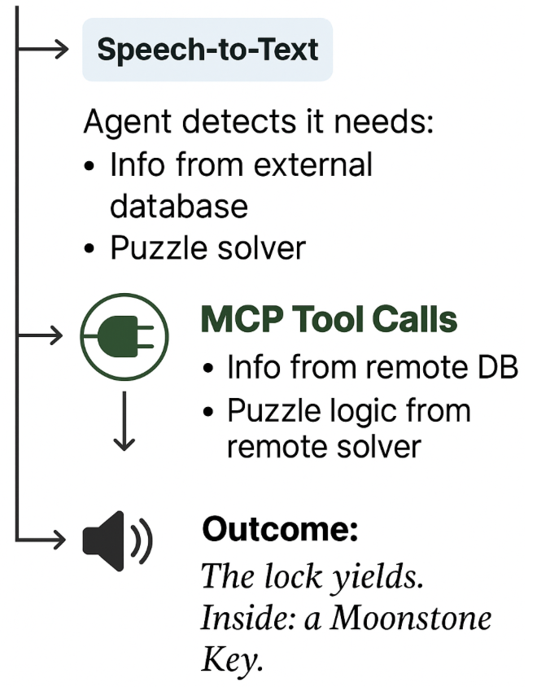
MCP in Action: Powering Szork’s World
In Szork, MCP lets the Dungeon Master agent reach out to any external tool mid-game, enriching the story, solving puzzles, and reacting to the player in real time.
Why this matters for Szork: Dynamic expansion —> Add new puzzles, items, or NPC behaviors from remote services without updating the game code.
Unified tool handling —> Local and external tools look identical to the agent.
Fast iteration —> Try new features during development or live events without deployment delays.
Future-proof —> Swap or upgrade tools as MCP evolves, without rewriting integrations.
Notes:
Let’s see how powerful MCP is through an example. In Szork, the agent is our Dungeon Master — it drives the story, keeps track of the game state, and reacts to whatever the player says. But sometimes, the agent needs more than just its own memory.
Without MCP, every new external feature — a lore database, a puzzle solver, a weather feed — would require a custom integration baked into the game code. That’s time, complexity, and maintenance overhead.
With MCP, Szork can discover and call these external tools dynamically, in the middle of gameplay, through one standard protocol. From the agent’s point of view, MCP tools look exactly like local ones. That means the Dungeon Master can, in one turn, pull backstory from a remote database, run a riddle through a puzzle solver, and then blend those outputs into the narration, without the player even knowing it left the local game environment.
It’s also future-proof: when we want to add new mechanics, we don’t touch the game loop — we just point the MCP registry to a new tool server.
MCP can connect Szork to tools outside its own world. It makes the game richer, more flexible, and infinitely expandable.

Slide 11

Retrieval-Augmented Generation
Beyond Games
RAG Architecture
Grounded by design: Retrieve → Generate ⇒ answers come with citations (receipts, not vibes).
Handle large sources - expands the context
Dynamically updatable: Update the index, not the model; smaller models + sharper context.
Latency as UX: Retrieval is part of the product—keep it snappy so interactions feel live.
Governance up front: Decide what’s eligible at ingest and enforce at retrieve; safe by design.
.
Notes:
Update data, not weights. - Gopi
RAG is built to keep answers grounded. First we retrieve the facts, then we let the model generate — so every claim can come with receipts, not guesses.
It scales to massive knowledge bases, so the context is richer. And when something changes, we just update the index, not the model — sharper answers, smaller models, lower costs.
Speed matters — in Szork, if the player asks about a new quest or lore, retrieval has to feel instant or the magic breaks. That’s why we treat latency as part of the user experience.
And governance starts at the door: we decide what data is allowed in and enforce it at retrieval, so every answer is safe by design.
This is how LLM4S makes RAG not just work — but work live, in games and beyond.

Slide 12
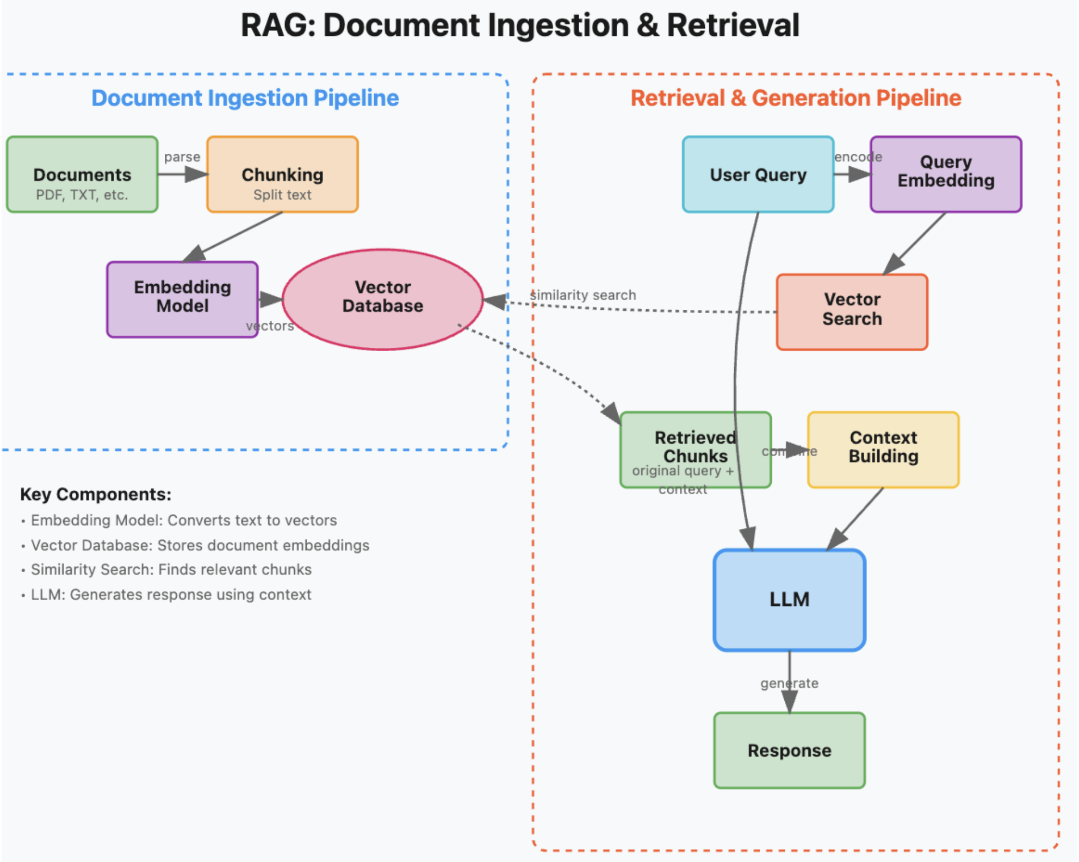
Notes:
Basically, Retrieval augmented generation is a way to make LLMs smarter and more reliable by giving them the right facts before they start writing.
On the left, you see the ingestion pipeline: we take documents, break them into chunks, turn them into vector embeddings, and store them in a database. This is like stocking a well-organized library.
On the right is the retrieval & generation pipeline: when a user asks a question, we embed the query, search for the most relevant chunks, and send those — plus the question — to the LLM. The model then writes its answer using that grounded context.
The benefit? You get up-to-date, source-backed answers without retraining the model. If your knowledge changes, you just reindex the data. It’s faster, cheaper, and keeps outputs connected to real, verifiable information.
In short: update your data, not your weights — and your LLM stays sharp and current

Slide 13
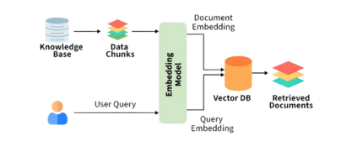
Built (now)
EmbedX plug-in embeddings → extract → chunk → embed → retrieve.
UniversalExtractor: .pdf/.txt/.csv/xlsx/.docx/URL.
Answers with receipts (citations on); no retrieval = no answer.
Config-driven model swap; FAISS baseline; structured logs.
Next (in flight)
PGVector: DB-backed retrieval + SQL filters + fast index.
Multimodal embeddings (text + image).
Tokenizer-aware chunking, hybrid search + light re-ranker.
Scoreboard: accuracy • coverage • cost • safety.
Notes:
Think of EmbedX as the backbone of our retrieval stack: extract → chunk → embed → retrieve. Every answer comes with receipts — citations are always on — and if retrieval returns nothing, we’re honest about it. No retrieval, no answer.
The entire system is config-driven, not code-driven. That means we can swap embedding models without rewrites, and FAISS already proves the loop works. Structured logs give us full transparency for audits and debugging.
It’s plug-and-play RAG: change the data, reindex, and the system’s behavior updates automatically — cheaper answers, cleaner audits.
Next, we’re moving to PGVector for database-backed retrieval and governance. We filter before we fetch: by team, by sensitivity, by freshness. Then we add smarter capabilities — multimodal embeddings when images matter, tokenizer-aware chunking for better semantic matches, and hybrid search with a light re-ranker to sharpen top results without blowing our latency budget.
Our scoreboard keeps us accountable: accuracy, coverage, cost, safety, and p95 latency. Our mantra stays simple — update data, not weights; SQL before search; receipts over vibes.

Slide 14

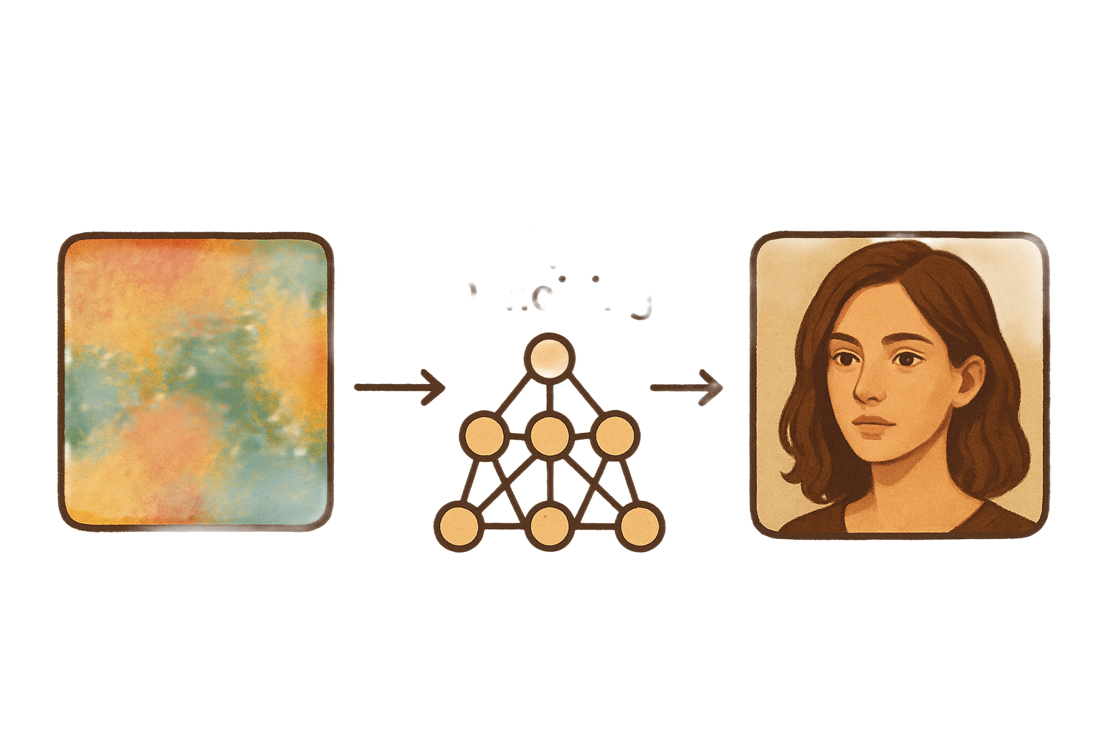
Multimodality: Image Generation and Processing
Create Images, Whenever you feel like it!
Stable Diffusion at work
Image Generation – Uses advanced AI models like GANs, VAEs, and diffusion models to create new images from scratch, often guided by inputs such as random noise, text descriptions, or reference images.
Notes:
Multimodality - Anshuman
“In AI, multimodality means working with more than one type of data — for example, combining text, images, audio, or video. Instead of just answering questions in words, a multimodal system can also show you a picture, analyze an image, or even generate one. This opens up more creative, interactive, and useful applications — from education to design to healthcare.”
Image Generation
“One of the most exciting parts of multimodality is image generation — turning an idea, described in words, into a visual output. AI models can understand descriptive text and produce realistic, artistic, or completely imagined images. This technology is now widely used in design tools, marketing, entertainment, and research.”
How Stable Diffusion Works
“Stable Diffusion is a type of AI model that creates images step-by-step. It starts with random noise — like TV static — and slowly removes the noise, guided by your text description, until a clear image appears. The ‘stable’ part means it balances creativity with consistency, so you can generate high-quality images without them going completely off-track.”

Slide 15





Supporting image, voice and other LLM modalites
Enabled Image Generation in LLM4S: Support generating images
Unified API Design: User-friendly interface with different image generation services
Speech to Text Support: With multiple backends, including lightweight offline (CMU Sphinx) and high-accuracy (Whisper) options.
Text-to-Speech (TTS): Simple interface with Tacotron2 for natural, clear voices that work out of the box.
Voice Controls & Output: Let users adjust voice, pace, and tone and validate with multiple languages/accents.
Notes:
Work in LLM4S
“For LLM4S, we added image generation capabilities so that it’s not limited to text anymore. We designed a simple interface that works with multiple image generation backends — including Stable Diffusion and online APIs. Users can now create images directly from their prompts, with easy options to customize size, style, and other details — all within the same library.”
Features that are coming up→Speech-to-Text (STT)
“We’re adding the ability to turn spoken audio into text, with two main options — CMU Sphinx for a lightweight, offline setup, and Whisper for very high accuracy. This gives users flexibility depending on whether they value speed, privacy, or accuracy.”
2. Better Transcripts
“To make sure transcriptions are clean and easy to read, we process the audio before recognition — removing background noise, adjusting volume levels, and handling other quality issues.”
3. Text-to-Speech (TTS)
“On the other side, we allow the system to speak text aloud. We’re integrating Tacotron2 to produce natural, human-like voices so the results sound clear and pleasant.”
4. Voice Controls & Output
“We also want to give users creative control over the voice — adjusting tone, speed, and style. Plus, we support common audio formats and test with various languages and accents to make it more inclusive.

Slide 16
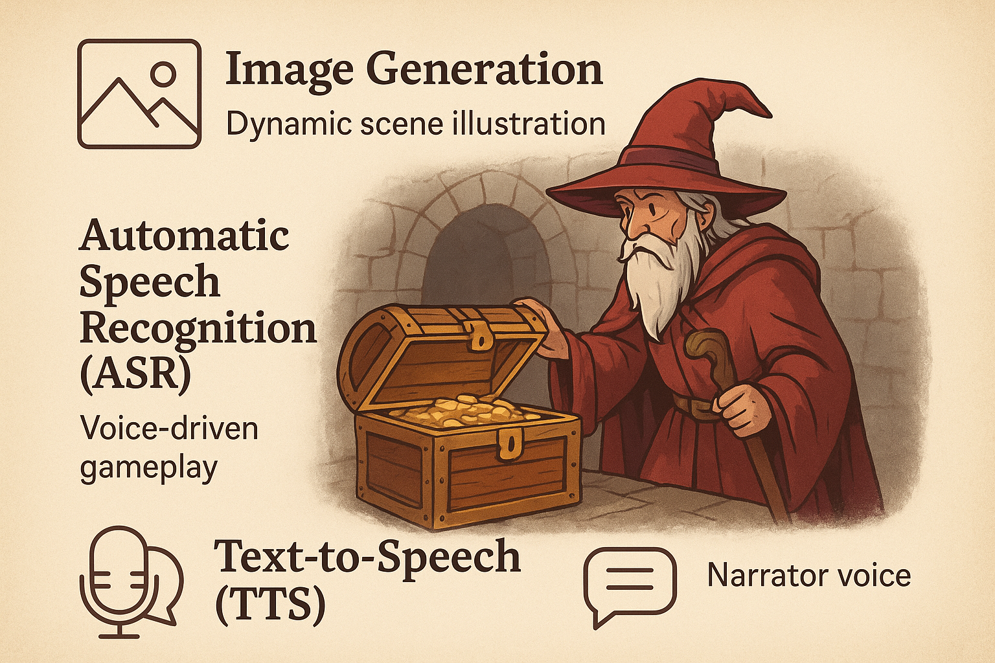
Features in Interactive RPG Gameplay: SZORK
Notes:
Image Generation – Dynamic Scene Illustration
“In our game, the visuals adapt to the player’s choices. If you open a treasure chest, defeat a dragon, or enter a dark forest, the system instantly generates a matching scene illustration. This keeps every playthrough visually unique and immersive.”
2. Automatic Speech Recognition (ASR) – Voice-Driven Gameplay
“Instead of typing commands, players can simply speak their actions through the mic. The AI understands the instructions and responds in real time, creating a smoother and more natural roleplaying experience.”
3. Text-to-Speech (TTS) – Narrator Voice
“The AI also brings the story to life by speaking the narration aloud. This can be a dungeon master’s voice, an NPC’s dialogue, or even atmospheric scene descriptions, making the world feel alive and interactive.”
Overall, Multimodality empowers LLM4S to go beyond text, enabling richer, more interactive, and creative experiences by seamlessly combining images, audio, and speech for a truly versatile AI platform.

Slide 17

LLM4S Enhanced Tracing
In LLM4S, tracing is like a detailed “black box recorder” for AI agents.
It tracks every step an agent takes from receiving a user’s question, to calling tools, to generating the final answer.
Tracing That Turns AI’s Black Box Into a Glass Box
Key Features:
Records every important event in an AI agent’s lifecycle
Captures user queries, LLM responses, tool calls, and errors
Works across different environments - from local testing to production
Think of it as a “play-by-play replay” of your AI’s decision-making
Notes:
Shubham - Tracing is a comprehensive logging tool that meticulously records every step an AI agent takes.
The goal is to provide a clear, detailed record of the agent's decision-making process. This includes everything from the initial user query to the final output, as well as all the internal steps.
The key features of this system are:
Event-Driven Logging: This records every significant event in an agent's lifecycle, giving us a complete operational timeline.
Data Capture: It captures all critical information, including user inputs, LLM responses, tool calls, and any errors that occur.
Environment Agnostic: The system is designed to work seamlessly across different environments, from local development to production.
Actionable Insights: It provides a full "play-by-play" of the AI's actions, which is invaluable for understanding and debugging complex behaviors.

Slide 18
Tracing & Observability in LLM4S
Tracing systems transform raw LLM executions into structured, visual, and analyzable traces enabling teams to understand, debug, and optimize AI workflows.
LangfuseTracing → Rich Visual Analytics
When to use: Performance tuning, multi-step debugging
Interactive timelines of prompt → response → tool calls
Metrics for latency, token usage, and cost per run
Perfect for deep dives in production scenarios
Console Tracing → Lightweight & Instant
When to use: Local dev, quick iterations
Prints structured trace logs directly to the terminal
Zero setup, minimal overhead
Ideal for debugging logic flow without external tools
NoOp Tracing → Tracing Disabled
When to use: Max performance, production cost savings
No tracing data collected or stored
Minimal CPU/memory impact
Useful for testing performance without observability overhead
Notes:
Tracing & Observability in LLM4S (40 seconds)
(0-5 seconds) This slide explains how our tracing system transforms raw LLM executions into structured, visual data, enabling us to understand, debug, and optimize our AI workflows.
(6-18 seconds) We have three distinct modes. First, Langfuse Tracing is for rich visual analytics. Use this for production to get interactive timelines and key metrics on latency, token usage, and cost per run. It’s perfect for deep dives into production scenarios.
(19-30 seconds) Next, Console Tracing is lightweight and instant. It's designed for local development and prints structured logs directly to your terminal. It has zero setup and is ideal for quickly debugging your logic flow.
(31-40 seconds) Finally, NoOp Tracing is for when tracing is disabled. This mode provides maximum performance with minimal CPU impact. It’s useful for performance testing where you want zero observability overhead and for when you need to save on production costs.

Slide 19
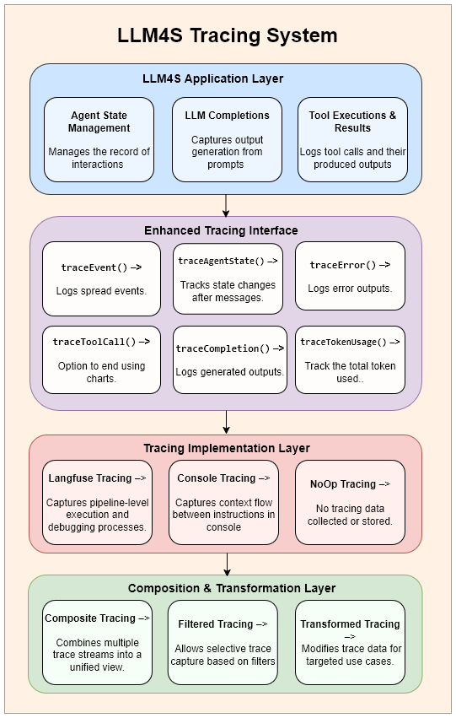
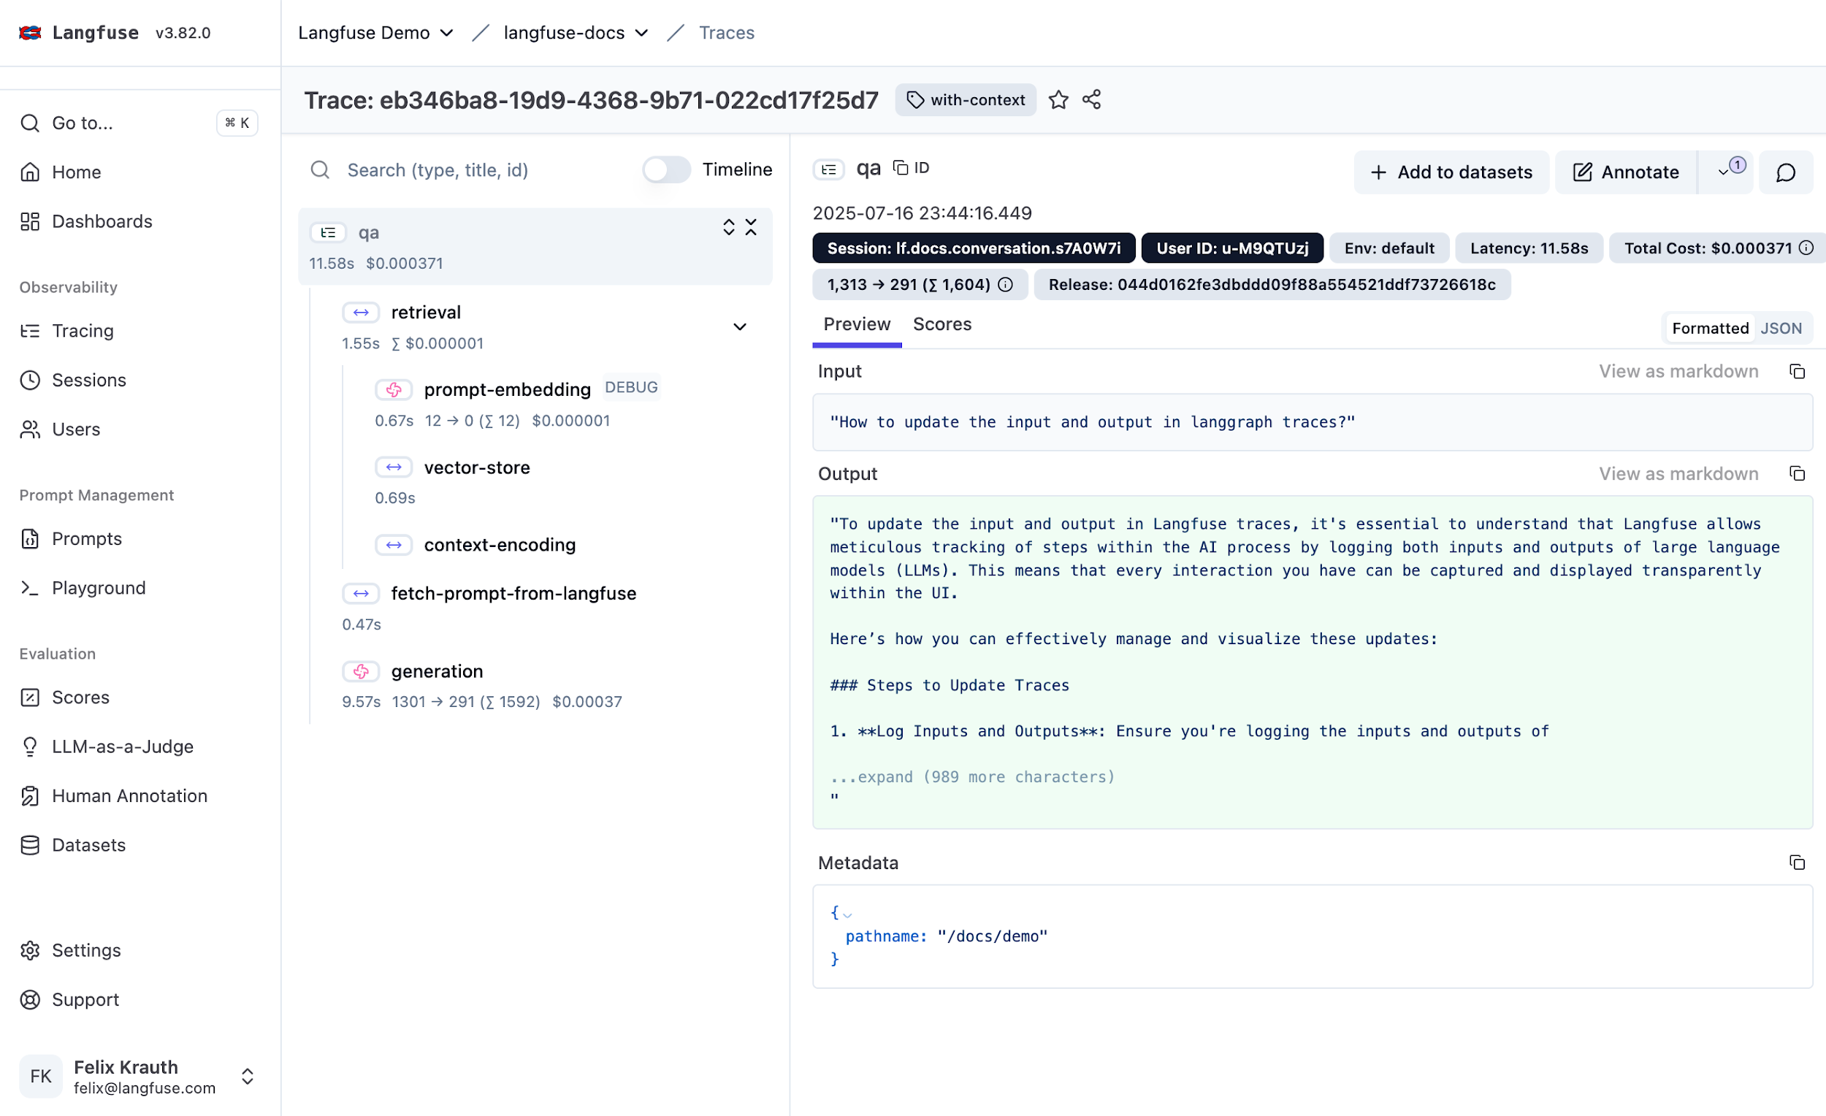
Tracing in Action – Langfuse for LLM4S
Step-by-Step Trace Visualization in Langfuse
Flowchart of LLM4S Tracing
Tracing transforms AI from a black box into a glass box, revealing every step with clarity.
Notes:
Now let's see our tracing system in action. This slide shows a real-world trace from the Langfuse dashboard, our production-grade observability backend. This is how we transform the AI's "black box" into a "glass box."
(11-30 seconds) As you can see, the dashboard provides a detailed, step-by-step visualization. The hierarchical view on the left shows the entire journey, from the initial user query, through all the internal steps like tool calls and generations, to the final response. This allows us to see exactly what happened and in what order.
On the right, we have our system flowchart as a quick reminder of how this all works. Our LLM4S Application Layer sends events through the Enhanced Tracing Interface. This is then picked up by the Langfuse Tracing Implementation, which captures all this rich data and sends it to the Langfuse platform for this kind of visualization.
(46-60 seconds) This integration is key to our production readiness. It gives us powerful visual analytics, metrics for latency and cost, and an interactive timeline for debugging. This isn't just about logging; it's about providing the actionable insights needed to build, monitor, and optimize reliable LLM applications at scale.

Slide 20
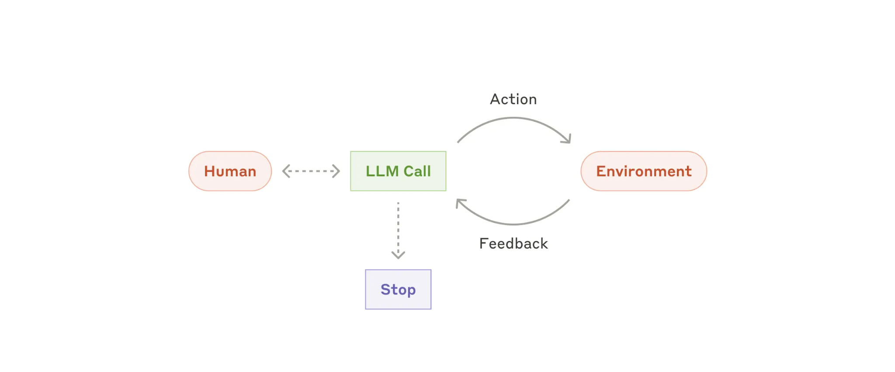
Agents
write code
run tests
run shell commands
Code execution environment
(container)
Code Spec
Agent
Specification
Met
Observe results
Notes:
To make agents build software, we use what's called a Software Engineering (SWE) Agent. It works like this: the agent is given a task and a set of basic tools, and it operates in a continuous loop.
Here's how it works:
Core Tools: The agent uses simple tools like find (to locate files), read file, write file, and run command. Imagine being given just a Unix shell with these basic capabilities—it's slow, but it's enough to get the job done.
The Loop: The process begins with a human-provided specification, like an SRS document. The agent is placed in a sandboxed environment where it can use its tools to perform actions, such as writing code or running tests.
Evaluation: After each action, the agent evaluates its own work. It checks if the action's outcome meets the project's specification.
Closing the Loop: If the criteria are met, the loop closes and the project is considered complete. If not, the agent proceeds to its next action, continuing the cycle until the task is successfully finished.
Essentially, by giving an LLM a few fundamental tools and a clear objective, we can empower it to write software in a self-correcting loop, turning a basic instruction into a finished product.

Slide 21
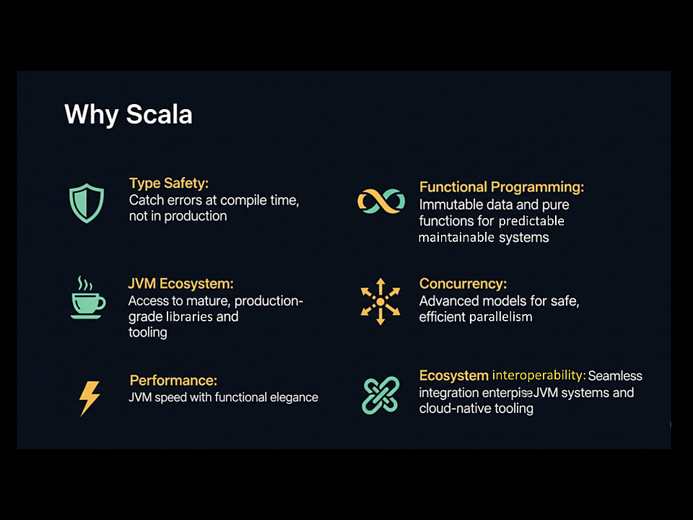
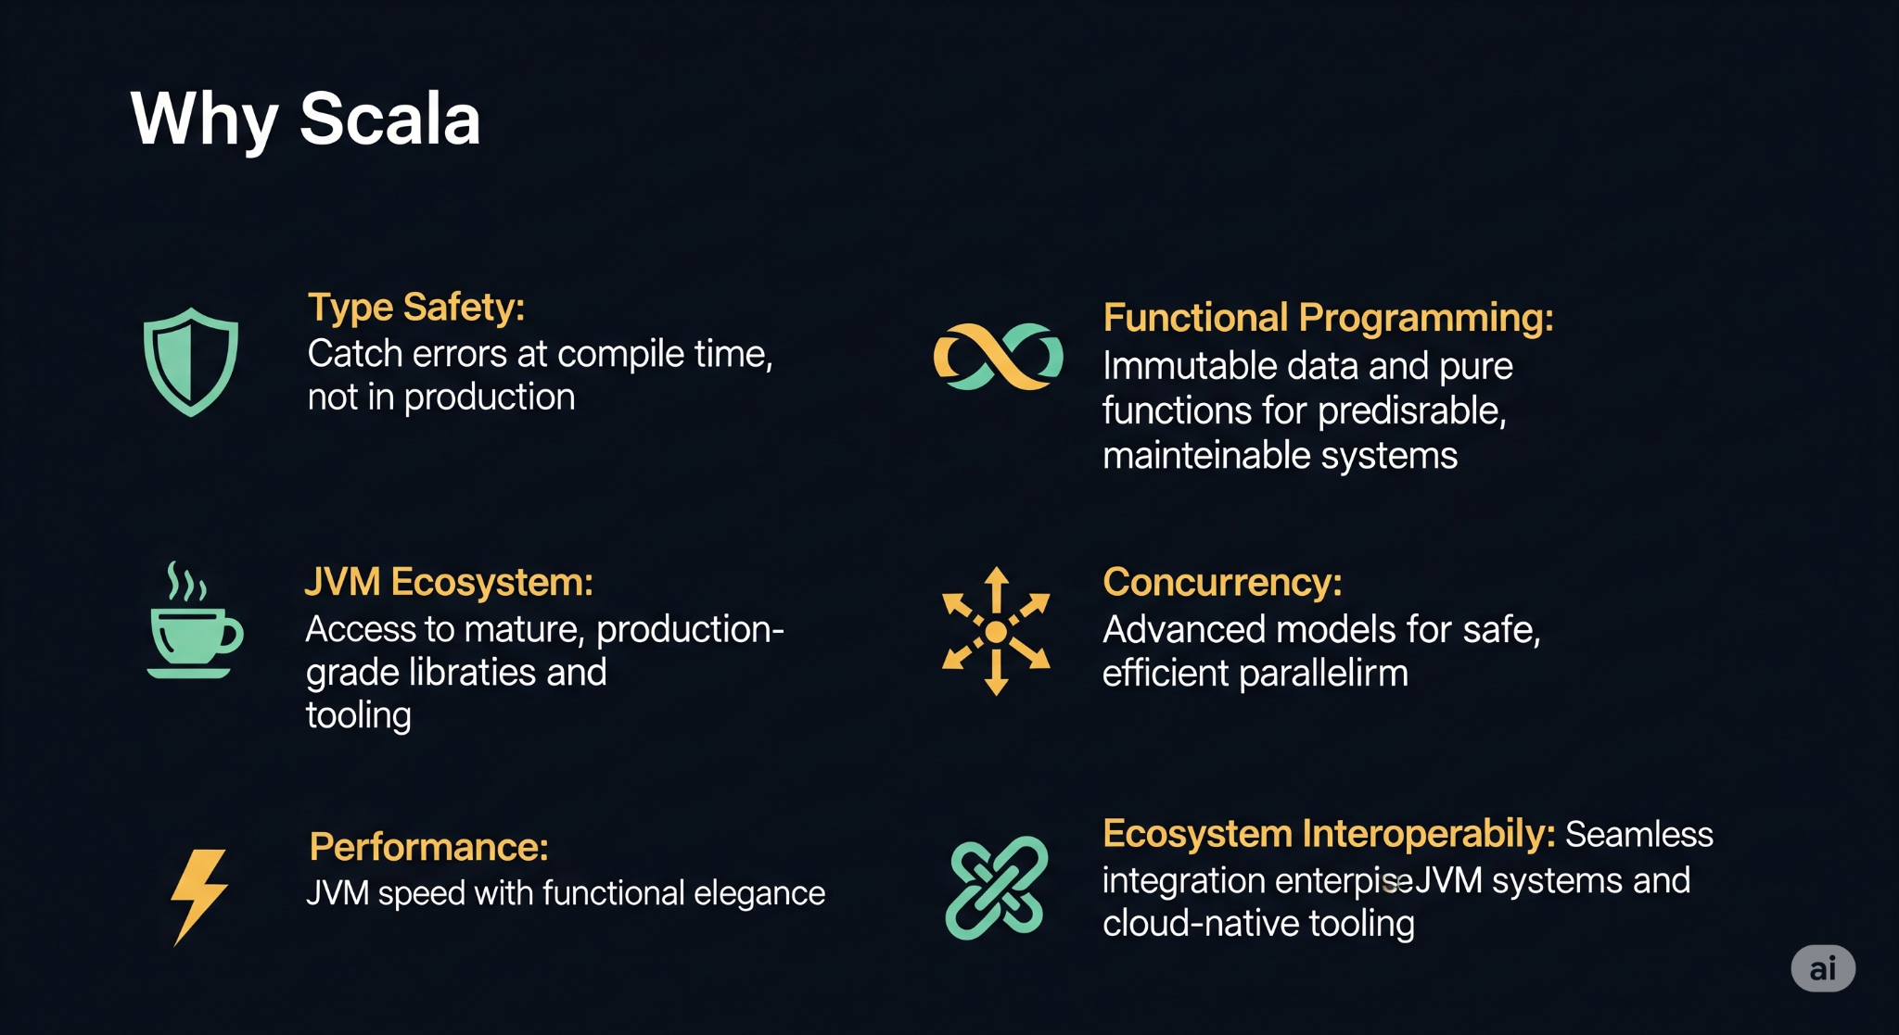



Why Scala for LLM Code generation?
Helps validate code
Helps LLM understand valid parameters
Provides good errors
Provides
accurate search
predictable
maintainable
libraries
parallelism
Great ecosystem
…
interoperability:
Notes:
Why scala Type Safety – Built-In Reliability “Scala’s strong static type system catches mistakes at compile time, giving instant feedback. This ‘fail fast’ approach means fewer runtime errors and safer AI-generated code.”
Functional Programming – Concise & Predictable “Immutability, higher-order functions, and pattern matching make code easier to reason about and less prone to hidden side effects—perfect for reliable automation.”
JVM Ecosystem – Massive Library Access “Scala runs on the JVM, unlocking decades of Java libraries and frameworks. This means AI-generated code can integrate instantly with proven enterprise tools.”
Concurrency – Scalable Performance “With tools like Akka, Futures, and Cats Effect, Scala handles high-throughput, distributed, and reactive systems without the headaches of manual threading.”
Performance – Java Speed, Scala Elegance “Scala compiles to JVM bytecode, delivering performance on par with Java—so AI-assisted solutions don’t just work, they scale.”
Ecosystem Interoperability – Plays Well with Others “Full interoperability with Java, Kotlin, and even native libraries makes Scala flexible for integrating with existing systems.”
Fail Fast Feedback – Better Developer + AI Loop “High-quality compiler errors act as a guide, not just a blocker—helping both humans and AI iterate quickly and correctly.”

Slide 22


Python - Fails at runtime
Result =
Notes:
Why Scala for AI? Type safety catches errors at compile time. Immutability prevents state bugs. True concurrency for parallel API calls. This matters at scale - when you're processing thousands of requests.

Slide 23
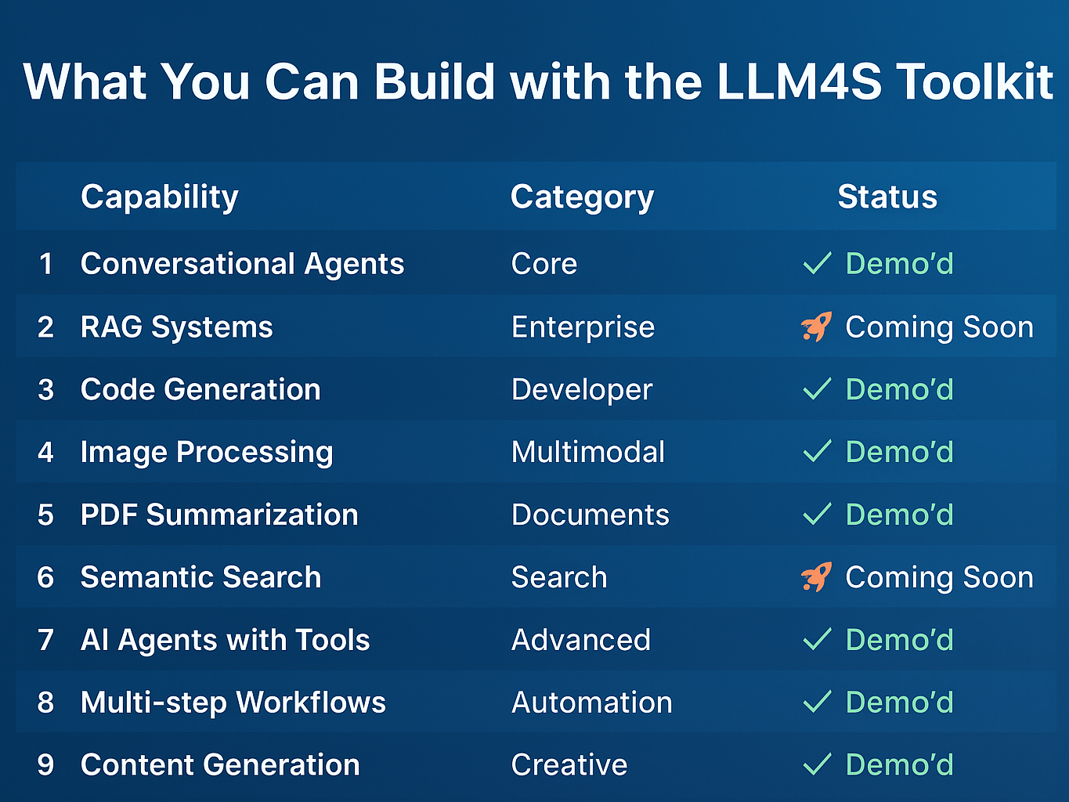
What You Can Build using LLM4S toolkit
Conversational Agents
RAG Systems
Code Generation
Core
Enterprise
Developer
✓ Demo'd
✓ Coming soon
✓ Demo’d
Image Processing
PDF Summarization
Semantic Search
Multimodal
Documents
Search
✓ Demo'd
✓ Demo'd
✓ Coming soon
AI Agents with Tools
Multi-step Workflows
Content Generation
Advanced
Automation
Creative
✓ Demo'd
✓ Demo'd
✓ Demo'd
Notes:
Everything on this slide - we've demonstrated it today. This isn't theoretical. You can build all of this with LLM4S, right now, in production, with Scala's safety and performance.

Slide 24



Ready to Build the Next Gen AI App?
Join Us! 😄
LLM4S GitHub Issues(https://lnkd.in/eXrhwgWY)
Explore the LLM4S project that bridges AI and Scala, fostering innovation in intelligent development
Star us on github 😉
Notes:
As we close, I encourage you to explore how Scala can enhance AI development. Think about what a type-safe AI ecosystem looks like and how we can push the boundaries of AI in functional programming.
Interested in contributing? Check out LLM4S on GitHub, explore open issues, and join us in building a type-safe, AI-powered Scala ecosystem. We greatly welcome collaboration from AI engineers, Scala developers, and open-source enthusiasts alike! If you enjoyed the talk, please consider starring the project on GitHub.

Slide 25
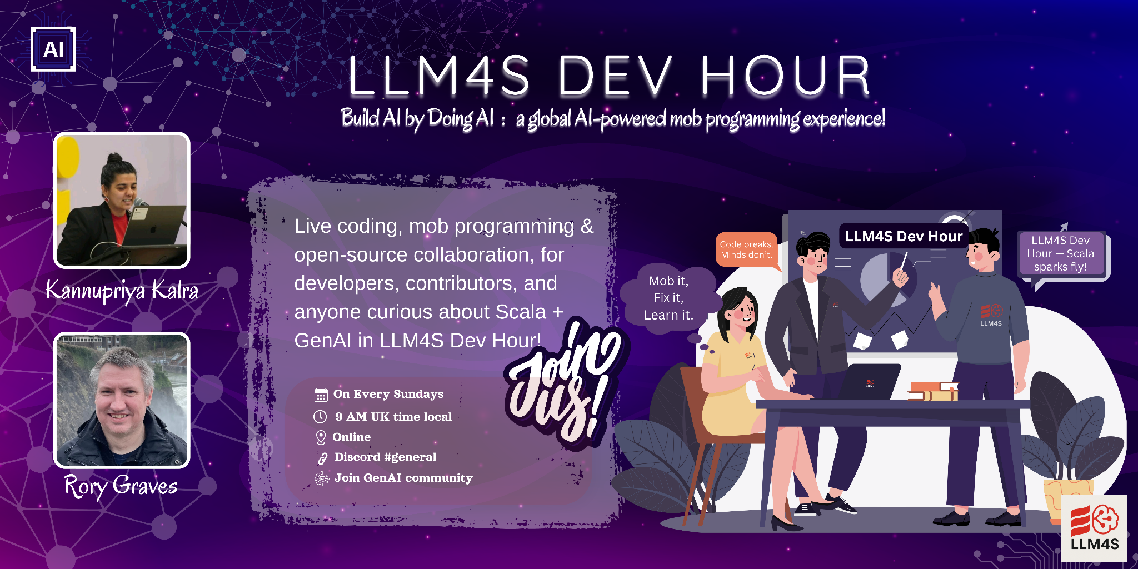
Notes:
I want to mention something that’s been a big help for the community — Dev Hour with Rory.
Every Sunday, Rory hosts an open, interactive session where he tackles your doubts live — whether they’re about Scala, AI workflows, or just general dev challenges.
It’s a great way to learn from real examples, see problems solved in real time, and even share your own blockers with the group.
If you haven’t joined yet, I highly recommend it — you’ll walk away with practical solutions and a stronger understanding of the concepts.

Slide 26



Join the Movement : Build the Cool Stuff
🌍 GenAI community:
Opportunity to learn AI while building AI
We are 100+ members from across globe
Notes:
The project gained immediate and remarkable traction following its launch. The community's response has been phenomenal in such a short period, reaching milestones of 100 GitHub stars and 100 community members. We were also honored to mentor four students for Google Summer of Code and have been incredibly impressed to see their rapid growth into confident open-source contributors.
As we close, I encourage you to explore how Scala can enhance AI development. Think about what a type-safe AI ecosystem looks like and how we can push the boundaries of AI in functional programming.
Interested in contributing? Check out LLM4S on GitHub, explore open issues, and join us in building a type-safe, AI-powered Scala ecosystem. We greatly welcome collaboration from AI engineers, Scala developers, and open-source enthusiasts alike! If you enjoyed the talk, please consider starring the project on GitHub.

Slide 27
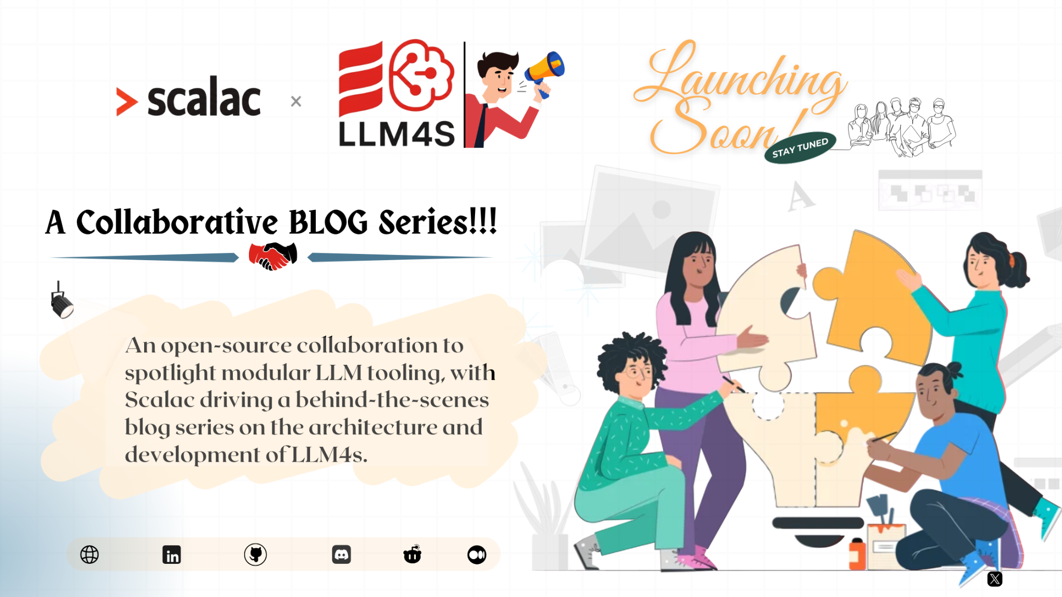
Notes:
I’m excited to share that this is a collaboration between Scalac and LLM4S. Together, we’re powering a new series of blogs designed to explore Scala, LLMs, and how they intersect in real-world applications.
This partnership is about combining deep Scala expertise with modern AI capabilities to deliver high-quality, developer-focused content.

Slide 28




Questions?
Kannupriya Kalra
Rory Graves
kannupriyakalra@gmail.com
@kannupriyakalra_46520
linkedin.com/in/kannupriyakalra
rory.graves@fieldmark.co.uk
@rorybot1
linkedin.com/in/roryjgraves
Notes:
We have a few minutes for questions. We'll also be around after the talk - come find us if you want to dive deeper into anything we've shown today.

Slide 29

Don’t forget to star us on Github :)
Notes:
Thank you for being a fantastic audience! Feel free to reach out, ask questions, and connect on LinkedIn. Let’s continue the conversation and work together to shape the future of AI and Scala!

Slide 30

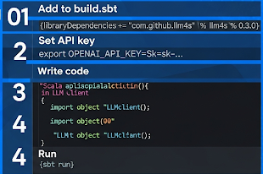

Getting Started
Getting Started with Szork Application
libraryDependencies += "com.github.llm4s" %% "llm4s" % "0.3.0"
export OPENAI_API_KEY="sk-..."
Resources:
• GitHub: github.com/llm4s/llm4s • Docs: [URL] • Discord: [Invite link]
Notes:
Getting started is this simple. Add one dependency, set your API key, write a few lines of Scala. Everything you saw today - SZork included - is open source. Star the repo if you like what you see!

Slide 31
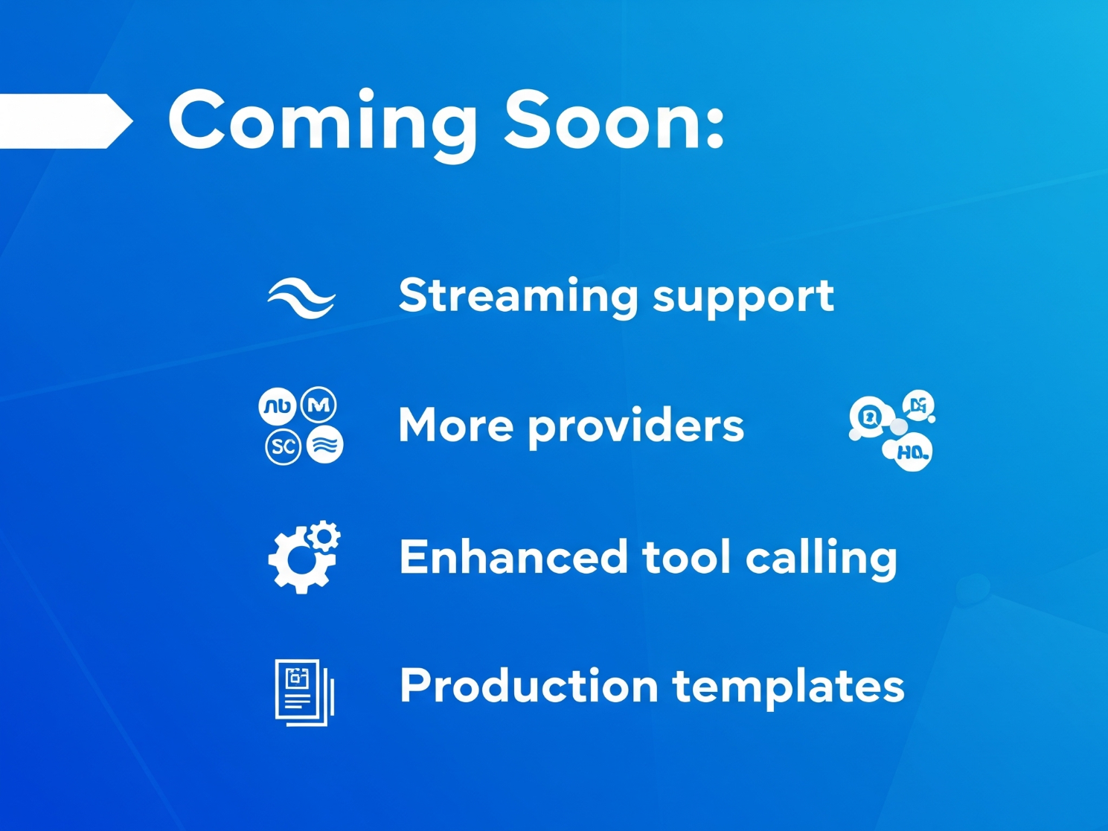
Coming Soon:
→ Streaming support
→ More providers
→ Enhanced tool calling
→ Production templates

Slide 32







LLM4S – Bringing AI to Scala
WHAT IS LLM4S?
HOW IT ENHANCES STRUCTURED, TYPE-SAFE AI DEVELOPMENT
CURRENT STATUS & ROADMAP
ROBUST TOOL CALLING
MULTI-STEP WORKFLOWS
AGENTIC PROGRAMMING
Notes:
Introducing **LLM4S**, a new Scala-first AI development toolkit. This project aims to bring structured, type-safe AI development to Scala. Here’s what LLM4S will offer:
- **Structured AI Workflows:** Ensuring AI-driven applications follow predictable, maintainable patterns.
- **Tool Calling & API Interactions:** Seamless integration with external tools, APIs, and databases.
- **Multi-step Workflows:** Supporting iterative development and feedback loops similar to Python's LangChain.
- **Agentic workflow framework**
- **Scala-Native AI Development:** Leveraging Scala’s strengths to improve reliability in AI workflows. - both in tooling and in code generation
Active development - GSOC
LLM4S is still evolving, but it promises to make AI development in Scala more accessible and efficient in multiple ways

Slide 33
Code Generation
Secure processing environment
Tools
Editting
LSP
Coding agent
Auto compilatin after action
Notes:
Watch this - we'll have AI generate a complete Scala tool. Notice the type safety - the AI respects Scala's type system. This isn't just code completion; it's understanding and generating idiomatic Scala.

Slide 34
Tool Calling in Action
Page Layout: Flow diagram with code examples
Visual Specification:
• Step-by-step flow visualization
• Code snippets at each step
• Success/error paths clearly marked
• Type signatures highlighted
Tool Calling Flow:
Lets show code from the examples
The steps par is nonsense.
Step | Action | Code
1 | Define tool | ToolFunction[Input, Output]
2 | Register | ToolRegistry(Seq(tool))
3 | LLM decides | complete(conversation, options)
4 | Execute | toolRegistry.execute(request)
5 | Return result | ToolMessage(id, result)
Notes:
Agents can call any tool you define. Here's a weather tool - the agent decides when to use it, executes it safely, and incorporates results. Next version of SZork will have inventory management tools!

Slide 35


Join the Movement : Build the Cool Stuff
Action | Link | QR Code
Star on GitHub | github.com/llm4s/llm4s
Join Discord | [https://discord.com/invite/YF2cWQD4cg]
Try SZork | [https://github.com/llm4s/szork]
Notes:
You can build the cool stuff! Everything is open source. We're looking for contributors. Join our Discord. Star the repo. And remember - if you can write Scala, you can build amazing AI applications. Questions?

